Slide 1
Interfaces in Java
Ruchika Patil
ruchika.rp@somaiya.edu

Slide 2
Outline
What is an Interface?
Creating an Interface
Implementing an Interface
What is Marker Interface?
Assignment

Slide 3
Abstraction in Java
Process of hiding the implementation details and showing only functionality to the user.
Ways to achieve Abstraction
1. Abstract class (0 to 100%)
2. Interface (100%)

Slide 4
Revise - Abstract class concept in Java
Declared as abstract
Can have abstract (methods without body) and non-abstract methods
It cannot be instantiated. (?)
It needs to be extended and its method implemented
It can have constructors and static methods also.
It can have final methods which will force the subclass not to change the body of the method.

Slide 5
Why we need Abstract class?
ANIMAL
DOG
CAT
LION

Slide 6
Abstract class Example
//abstract parent class
abstract class Animal{
//abstract method
public abstract void sound();
}
//Dog class extends Animal class
public class Dog extends Animal{
public void sound(){
System.out.println("Woof");
}
public static void main(String args[]){
Animal obj = new Dog();
obj.sound();
}
}

Slide 7
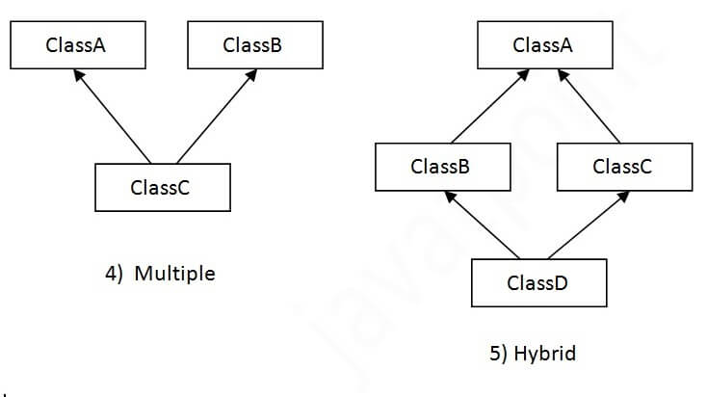

Java and Multiple Inheritance
Multiple Inheritance
Hybrid Inheritance

Slide 8
Example
class A{
void msg(){
System.out.println("Hello");}
}
class B{
void msg(){
System.out.println("Welcome");}
}
class C extends A,B{//suppose if it were
public static void main(String args[]){
C obj=new C();
obj.msg(); //Now which msg() method would be invoked?
}
}
Compile Time Error

Slide 9
Why Java doesn’t support multiple inheritance?
Java doesn’t allow multiple inheritance to avoid the ambiguity caused by it.
To reduce the complexity and simplify the language, multiple inheritance is not supported in java.
To provide more maintainable and clean design.

Slide 10
INTERFACE

Slide 11
Defining Interface
Interface in java is a blueprint of a class.
It defines only abstract methods and public, static and final fields.
It cannot have a method body.
reference type in Java
It cannot be instantiated just like the abstract class.
A Java library example is, Comparator Interface.

Slide 12
Why And When To Use Interfaces?
It is used to achieve abstraction and multiple inheritance in Java.
1) To achieve security - hide certain details and only show the important details of an object (interface).
2) Java does not support "multiple inheritance" (a class can only inherit from one superclass). However, it can be achieved with interfaces, because the class can implement multiple interfaces.

Slide 13
Interface Declaration
Syntax
interface <interface_name>{
// declare constant fields
// declare methods that abstract
// by default.
}

Slide 14
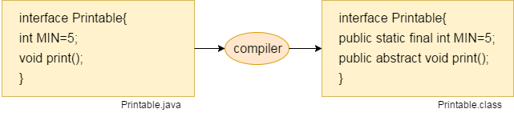
The Java compiler adds public and abstract keywords before the interface method. Moreover, it adds public, static and final keywords before data members.
Since Java 8, we can have default and static methods in an interface.
Since Java 9, we can have private methods in an interface.

Slide 15
Why not just use abstract classes?
The reason is, abstract classes may contain non-final variables, whereas variables in interface are final, public and static.
Java does not permit multiple inheritance from classes, but permits implementation of multiple interfaces.

Slide 16
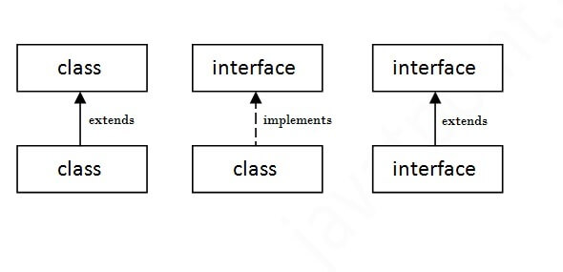
The relationship between classes and interfaces
Note: class implements interface, but an interface extends another interface.

Slide 17
Implementing Interface

Slide 18
Simple Example of Java Interface (1)
import java.io.*;
interface In1
{
// public, static and final
final int a = 10;
// public and abstract
void display();
}
// A class that implements the interface.
class TestClass implements In1
{
// Implementing the capabilities of
// interface.
public void display()
{
System.out.println(“Java Interface");
}
// Driver Code
public static void main (String[] args)
{
TestClass t = new TestClass();
t.display();
System.out.println(a);
}
}
Output:
Java Interface
10

Slide 19
Simple Example of Java Interface (2)
interface MyInterface {
void method1(); //jvm will understand its of public and abstract type
void method2();
}
class XYZ implements MyInterface {
public void method1() {
System.out.println("implementation of method1");//in method definition public specifier should be added compulsorily
}
public void method2() {
System.out.println("implementation of method2");
}
public static void main(String arg[]) {
MyInterface obj = new XYZ();
obj. method1();
}
}

Slide 20
Java Interface Methods
Every member of interface is only and only public whether you define or not. When method of the interface is defined in the class implementing the interface, we have to give it public access as child class can’t assign the weaker access to the methods.
Hence inside interface the following methods declarations are equal.
void methodOne();
public Void methodOne();
abstract Void methodOne();
public abstract Void methodOne();
Also, We can’t use the following modifiers for interface methods.
Private
protected
final
static
synchronized
native
strictfp

Slide 21
Assignment: 1
Compute area of rectangle and circle.
Demonstrate the use of interface.

Slide 22
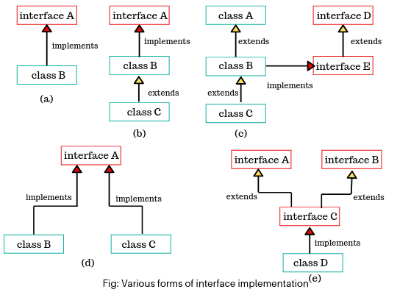
https://medium.com/@scientecheas

Slide 23
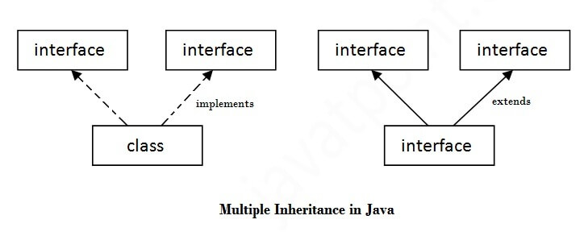
Multiple inheritance in Java by interface
If a class implements multiple interfaces, or an interface extends multiple interfaces, it is known as multiple inheritance.

Slide 24
Example: Class implementing multiple interfaces
interface intfA
{
void m1();
}
interface intfB
{
void m2();
}
// class implements both interfaces
// and provides implementation to the method.
class sample implements intfA, intfB
{
public void m1()
{
System.out.println("Welcome: inside the method m1");
}
public void m2()
{
System.out.println("Welcome: inside the method m2");
}
}
class Demo
{
public static void main (String[] args)
{
sample ob1 = new sample();
// calling the method implemented
// within the class.
ob1.m1();
ob1.m2();
}
}

Slide 25
Interface inheritance :
An interface can not implement another interface, but can extend the other interface. An interface can extend multiple interfaces but not classes.
public interface Inf1 {
public void meth1();}
public interface Inf2{
public void meth2();}
public interface MySubInterface extends Inf1, Inf2 {
public void meth3(); }
public class Demo implements MySubInterface {
public void meth1(){ System.out.println("method1"); }
public void meth2(){ System.out.println("method2"); }
public void meth3(){System.out.println("method3"); }
public static void main(String args[]){
Inf2 obj = new Demo();
obj.meth2(); }
}

Slide 26
Multiple inheritance is not supported through class in java but it is possible by interface, because:
Multiple Inheritance is not supported by class because of ambiguity
In case of interface, there is no ambiguity because implementation to the method(s) is provided by the implementing class up to Java 7.
From Java 8, interfaces also have implementations of methods. So if a class implementing two or more interfaces having the same method signature with implementation, it is mandated to implement the method in class also.

Slide 27
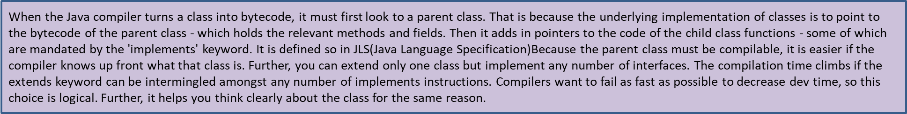
Extending class and interface
A class can extend only 1 class and multiple interfaces at same time but extends keyword should precede implements keyword.
interface printable{
void print(); }
class subclass {
void write(){System.out.println(“Java”);}}
public class Register extends subclass implements printable {
public void print(){System.out.println("Hello");}
public static void main(String args[]){
print();
subclass.write();
}

Slide 28
Tagged / Marker Interface
An interface which has no member is known as a marker or tagged interface, for example, Serializable, Cloneable, Remote, etc. They are used to provide some essential information to the JVM so that JVM may perform some useful operation.
package java.util;
public interface EventListener
{}

Slide 29
Nested Interface in Java
An interface i.e. declared within another interface or class is known as nested interface.
Nested interface must be public if it is declared inside the interface but it can have any access modifier if declared within the class.
Nested interfaces are declared static implicitly.

Slide 30
Example: Nested Interface
interface MyInterfaceA{
void display();
interface MyInterfaceB{
void myMethod();
}
}
class NestedInterfaceDemo1
implements MyInterfaceA.MyInterfaceB{
public void myMethod(){
System.out.println("This is Nested interface myMethod");
}
public static void main(String args[]){
MyInterfaceA.MyInterfaceB obj=
new NestedInterfaceDemo1();
obj.myMethod();
}
}

Slide 31
Summary
We can’t create instance(interface can’t be instantiated) of interface but we can make reference of it that refers to the Object of its implementing class.
A class can implement more than one interface.
An interface can extends another interface (but only one interface).
A class that implements interface must implements all the methods in interface.
All the methods are public and abstract. And all the fields are public, static, and final.
It is used to achieve multiple inheritance.
It is used to achieve loose coupling.

Slide 32
Sr. No. | Key | Abstract Class | Interface
1 | Supported Methods | Abstract class can have both an abstract as well as concrete methods. | Interface can have only abstract methods. Java 8 onwards, it can have default as well as static methods.
2 | Multiple Inheritance | Multiple Inheritance is not supported. | Interface supports Multiple Inheritance.
3 | Supported Variables | final, non-final, static and non-static variables supported. | Only static and final variables are permitted.
4 | Implementation | Abstract class can implement an interface. | Interface can not implement an interface, it can extend an interface.
5 | Keyword | Abstract class declared using abstract keyword. | Interface is declared using interface keyword.
6 | Inheritance | Abstract class can inherit another class using extends keyword and implement an interface. | Interface can inherit only an inteface.
7 | Inheritance | Abstract class can be inherited using extends keyword. | Interface can only be implemented using implements keyword.
8 | Access | Abstract class can have any type of members like private, public. | Interface can only have public members.

Slide 33
Q.) Output?
interface calculate
{
void cal(int item);
}
class display implements calculate
{
int x;
public void cal(int item)
{
x = item * item;
}
}
class interfaces
{
public static void main(String args[])
{
display arr = new display;
arr.x = 0;
arr.cal(2);
System.out.print(arr.x);
}
}
}

Slide 34
Assignment 2
Write a program to create interface named test. In this interface the member function is square. Implement this interface in arithmetic class. Create one new class called ToTestInt in this class use the object of arithmetic class.

